Slide 1
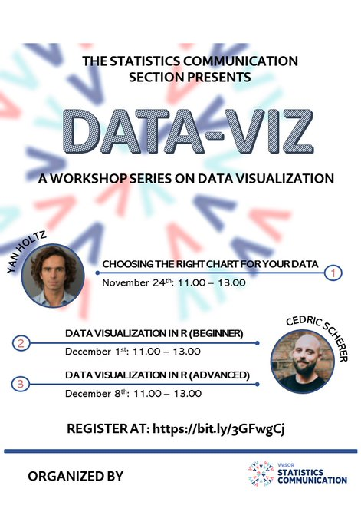

Slide 2
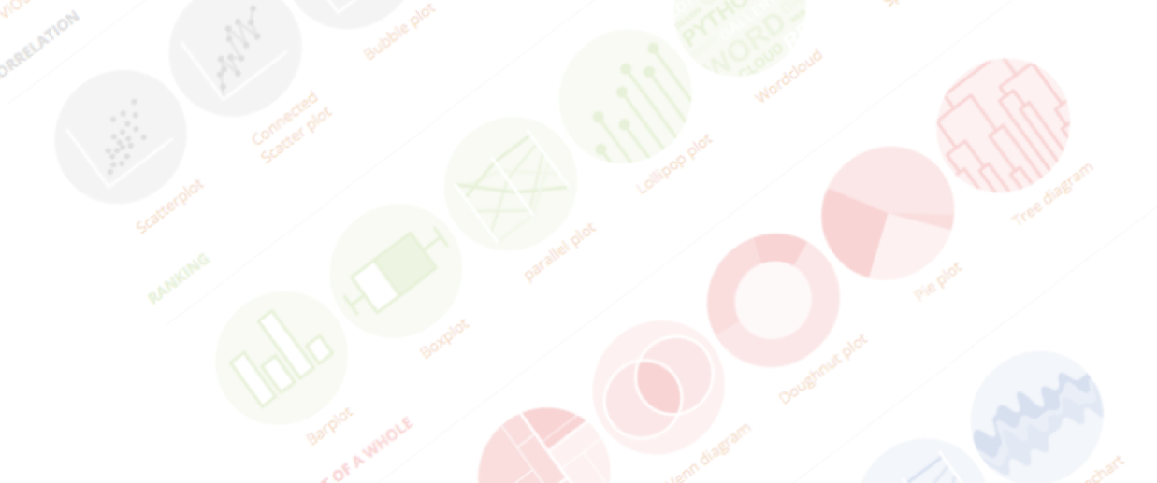

A project by Yan Holtz and Conor Healy
Choosing the right chart for your data
The Netherland & Remote | November 2021

Slide 3

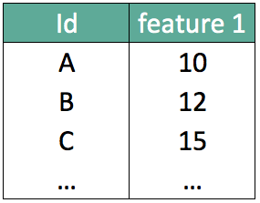
What should I do with my data ??

Slide 4
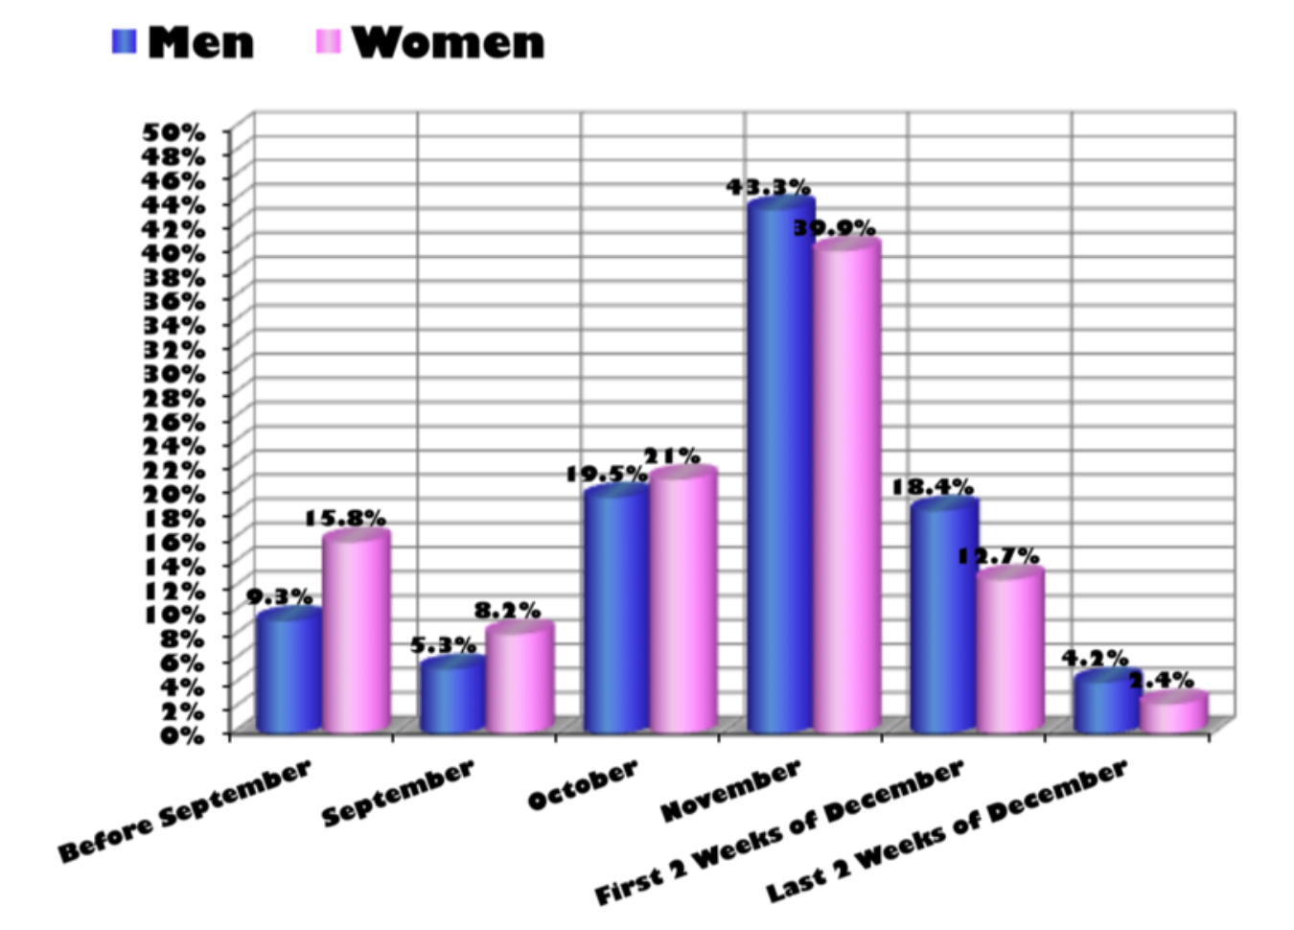
…
What about that?
Source: Storytelling with data by Cole Nussbaumer Knaflic

Slide 5

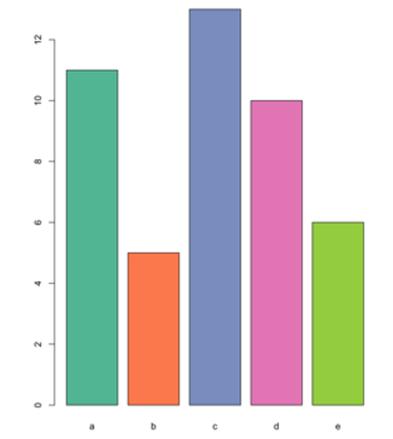

Design
Code

Slide 6
Design
Code

Slide 7
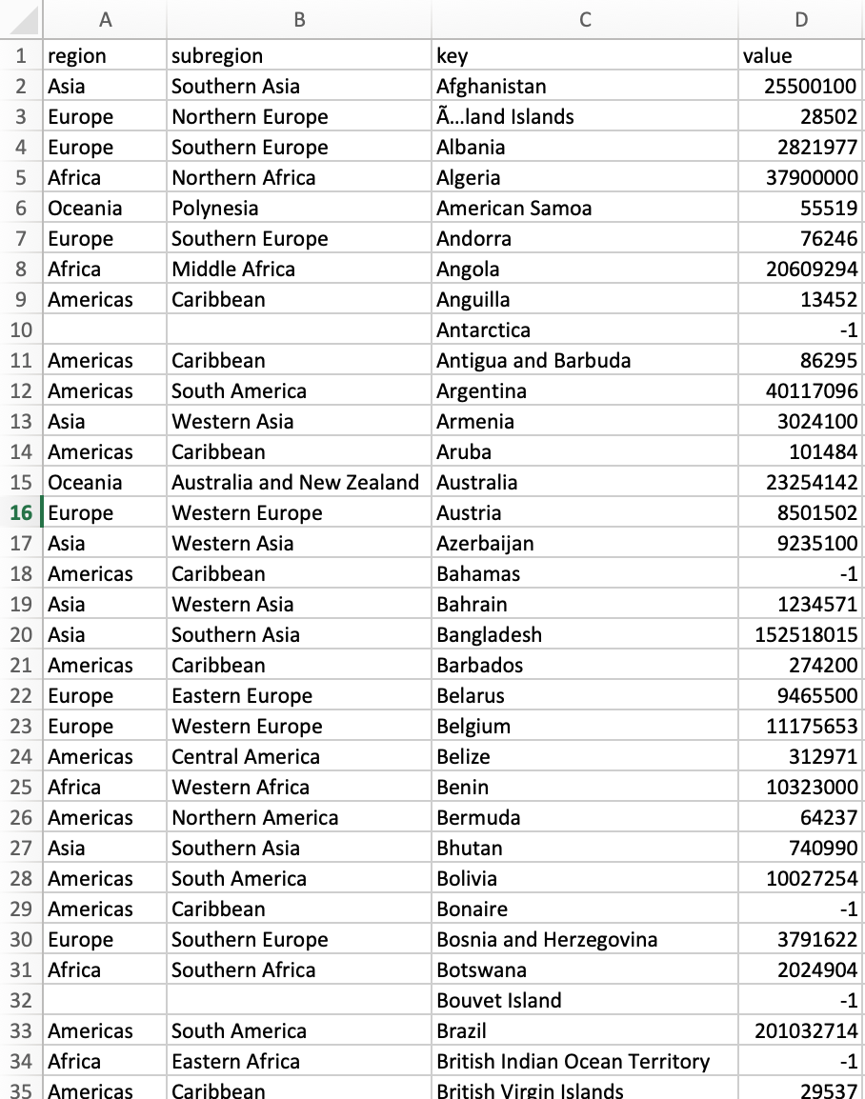

A chart,
why?
World population distribution
Biggest country?
Rank?
Distribution by continent?
Notes:
Dinéusorus

Slide 8
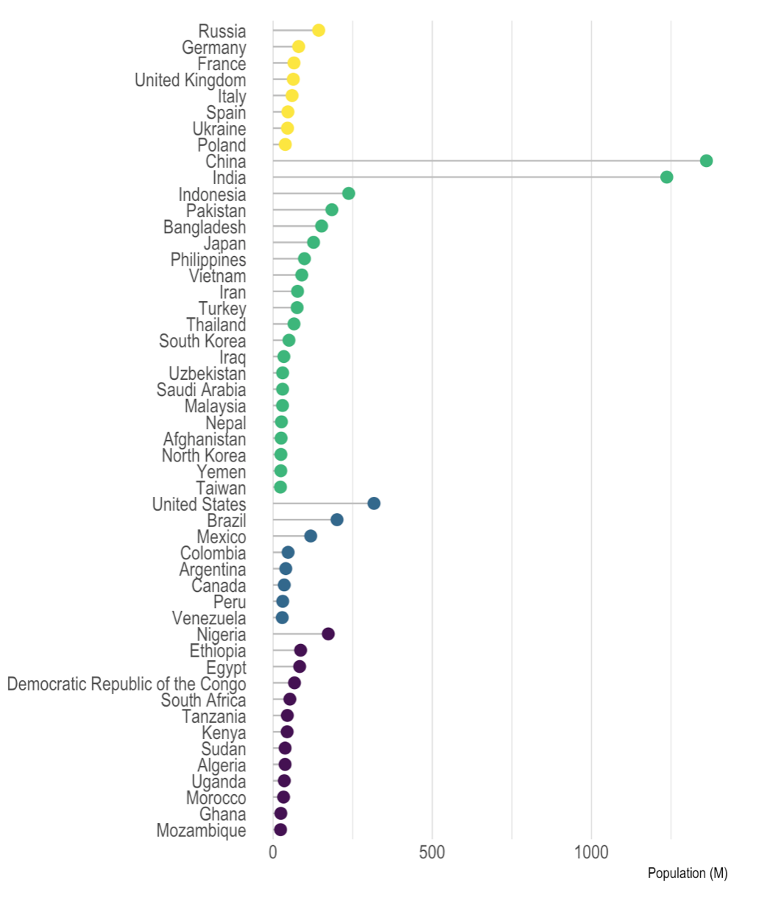
“Picture superiority effect”

Slide 9
Y = 3 + 0.5x
Cor = 0.8
Mean(x) = 9
Var(x) = 11
Mean(Y) = 7.5
Var(Y) = 4.1
OK, but we have summary statistics!
Anscombe's quartet
Anscombe et al. 1973
Notes:
Dinéusorus

Slide 10

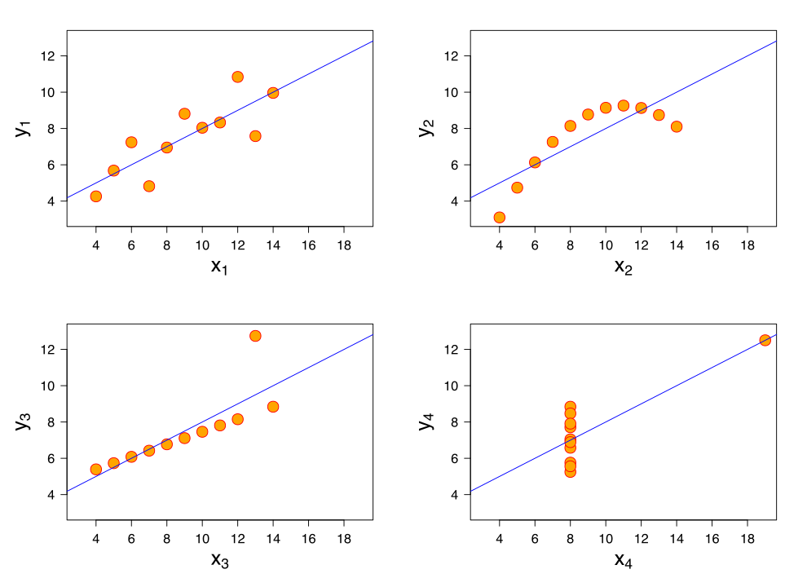
Y = 3 + 0.5x
Cor = 0.8
Mean(x) = 9
Var(x) = 11
Mean(Y) = 7.5
Var(Y) = 4.1
Notes:
Dinéusorus

Slide 11
Y = 3 + 0.5x
Cor = 0.8
Mean(x) = 9
Var(x) = 11
Mean(Y) = 7.5
Var(Y) = 4.1
Anscombe's quartet
Anscombe et al. 1973
Notes:
Dinéusorus

Slide 12
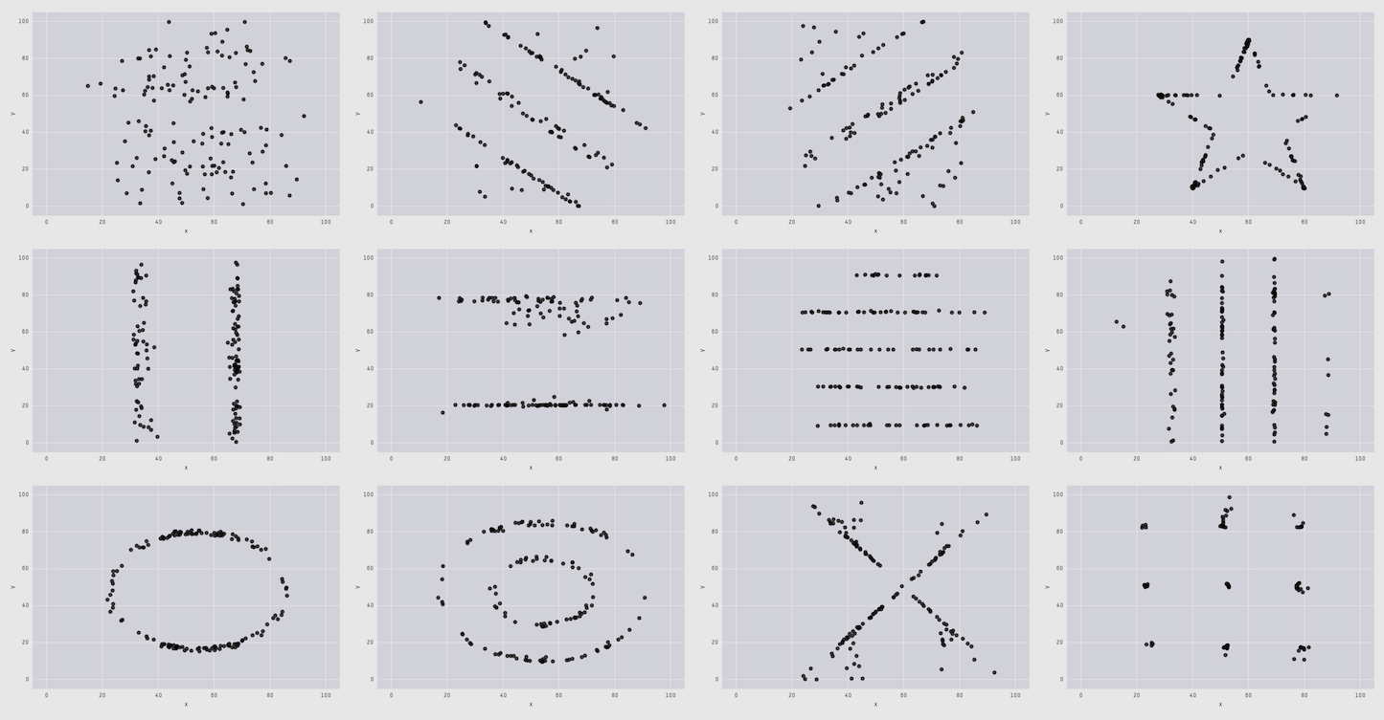
The Datasaurus Dozen
Cairo , 2017
Matejka & Fitzmaurice, 2017

Slide 13
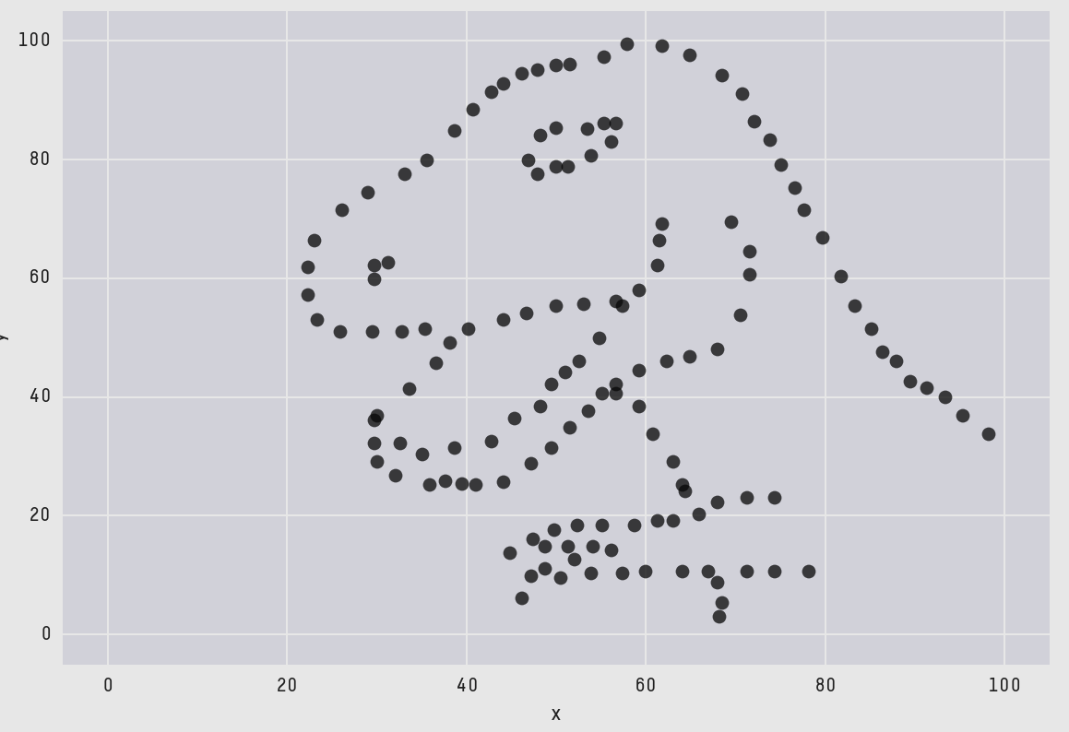
The Datasaurus Dozen
Cairo , 2017
Matejka & Fitzmaurice, 2017

Slide 14
Looking for a chart ?
What you can do
What you should do
Caveats to avoid
How to
build it

Slide 15
WHAT YOU CAN DO
A classification of chart types based on data input format
www.data-to-viz.com/#explore

Slide 16

Scatterplot

Slide 17

Scatterplot
2d density chart

Slide 18
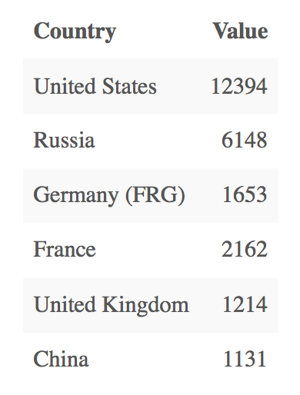
Who sells more weapons ?
?
Notes:
Very simple dataset,
-> What would you do ?
quantity of weapons exported by the top 50 largest exporters in 2017.
on the Stockholm International Peace Research Institute

Slide 19
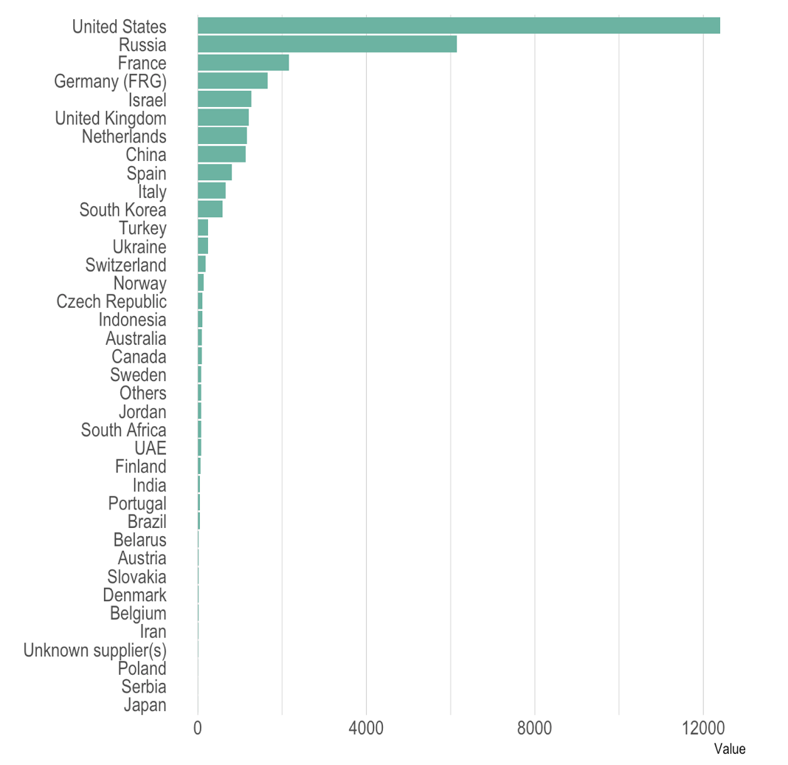
Who sells more weapons ?

Slide 20
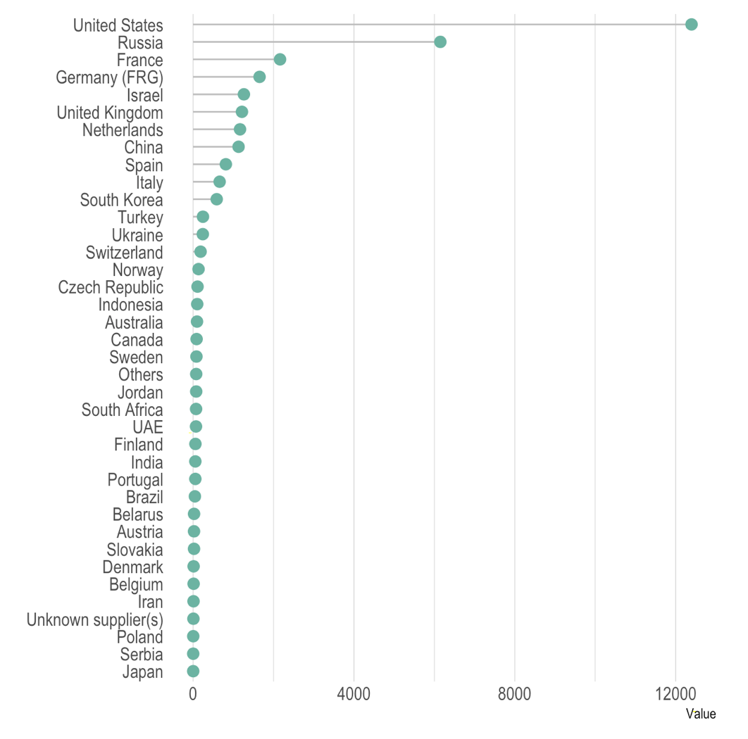
Who sells more weapons ?

Slide 21
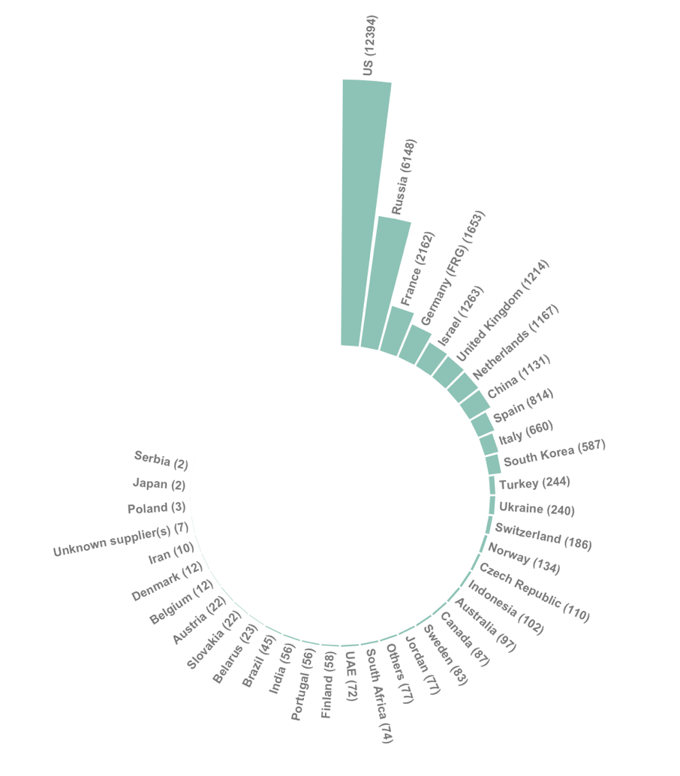
Who sells more weapons ?

Slide 22
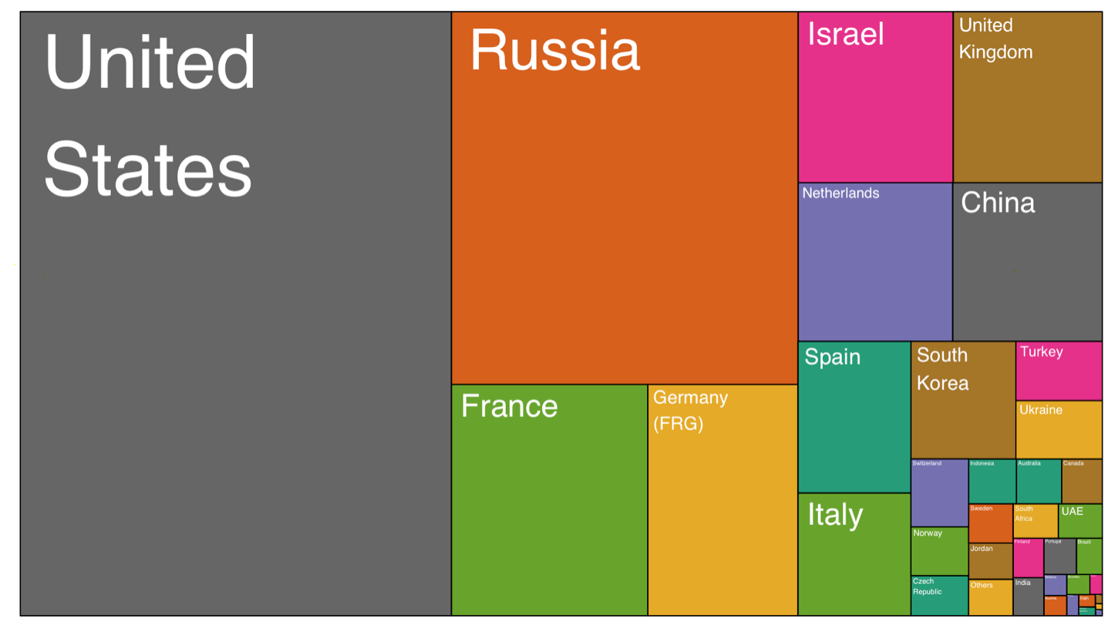
Who sells more weapons ?

Slide 23
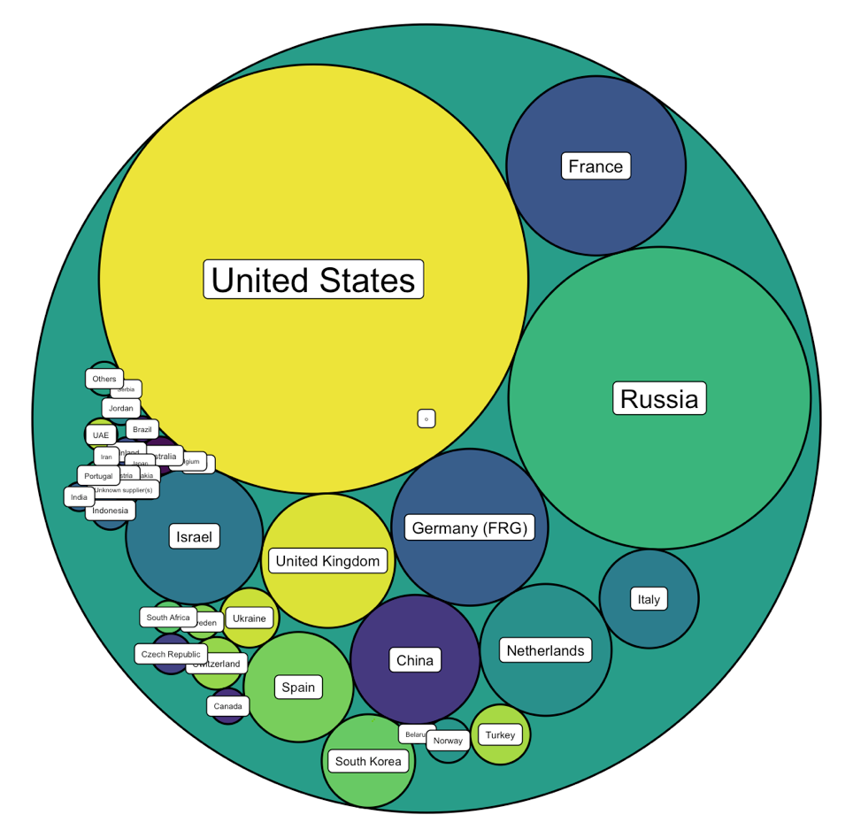
Who sells more weapons ?

Slide 24







Who sells more weapons ?

Slide 25
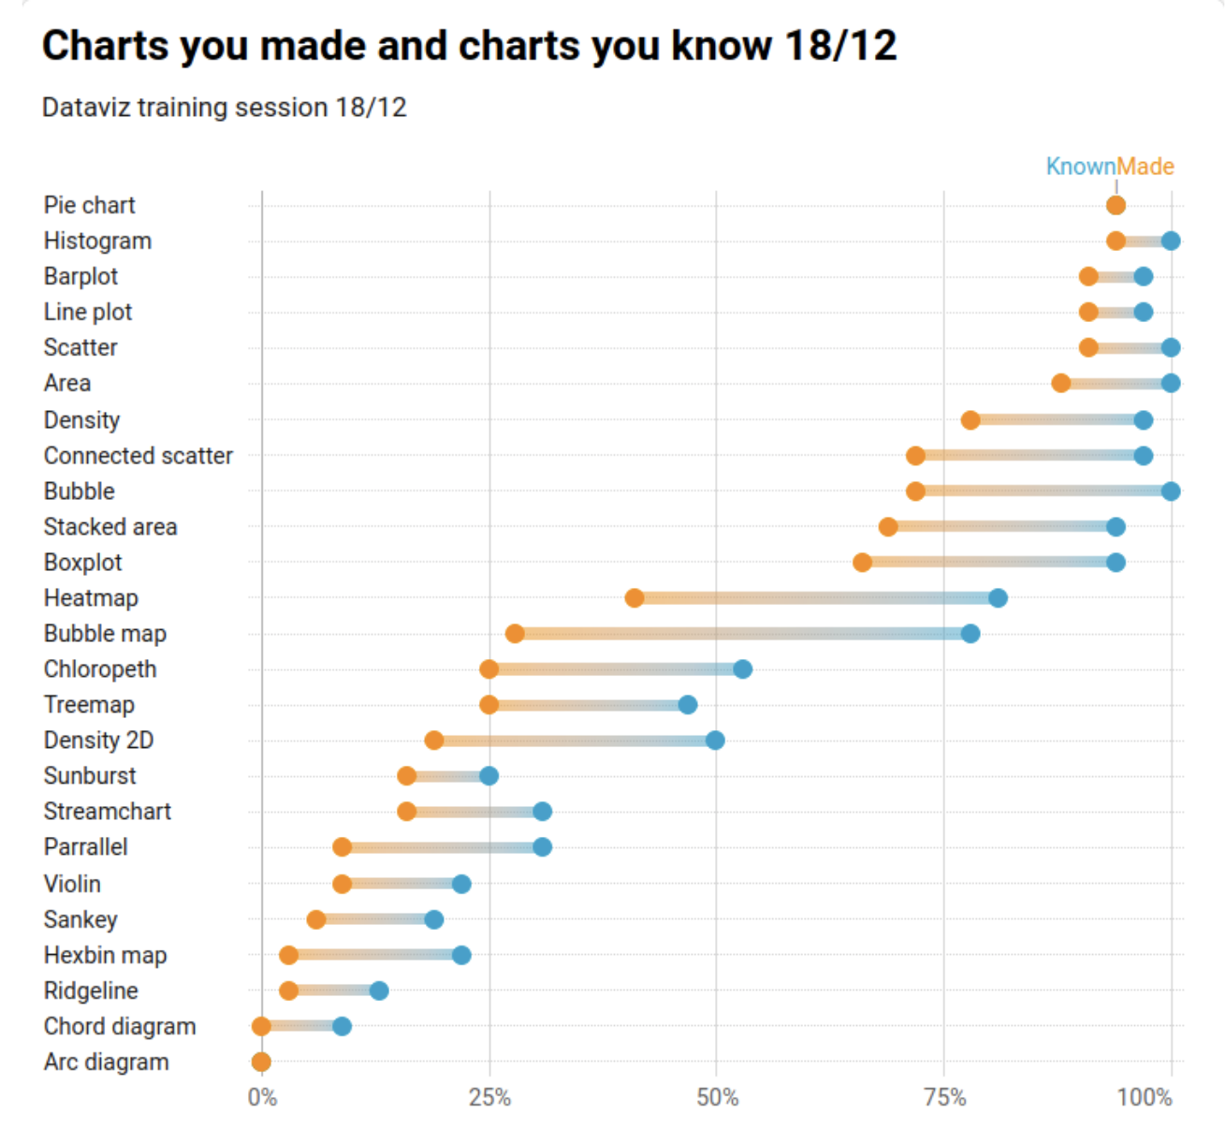

Slide 26
Who sells more weapons ?
1 observation per group
1 categorical variable
1 numerical variable

Slide 27
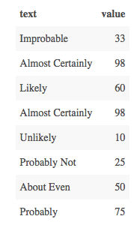
Perception of probability

Slide 28
Perception of probability
Several observations per group
1 categorical variable
1 numeric variable

Slide 29
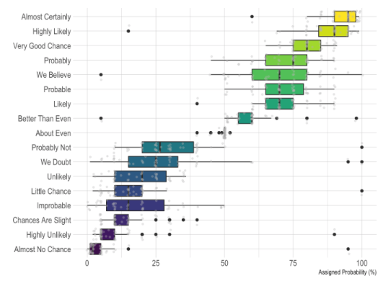
Perception of probability

Slide 30
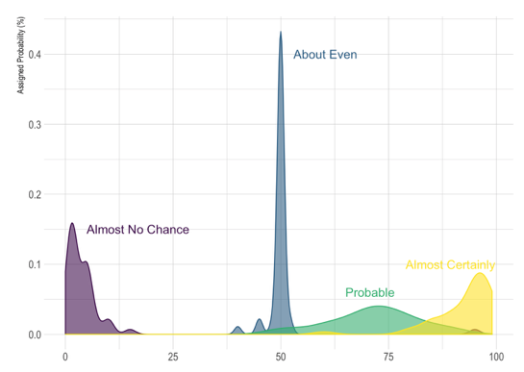
Perception of probability

Slide 31
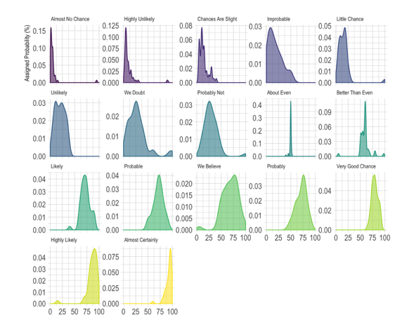
Perception of probability

Slide 32
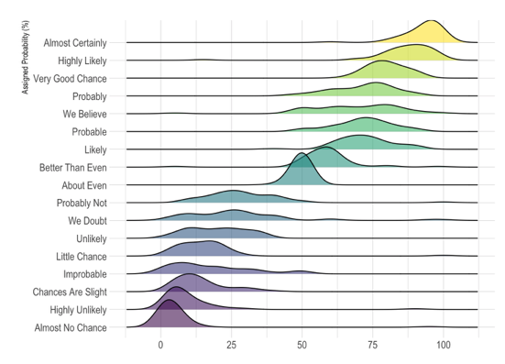
Perception of probability

Slide 33
So…
Knowing the possibilities is the first step in chart choice
Not easy to know all the chart types
Hard to figure out options from a dataset
Let’s build a decision tree
Notes:
Demo first part of the website

Slide 34
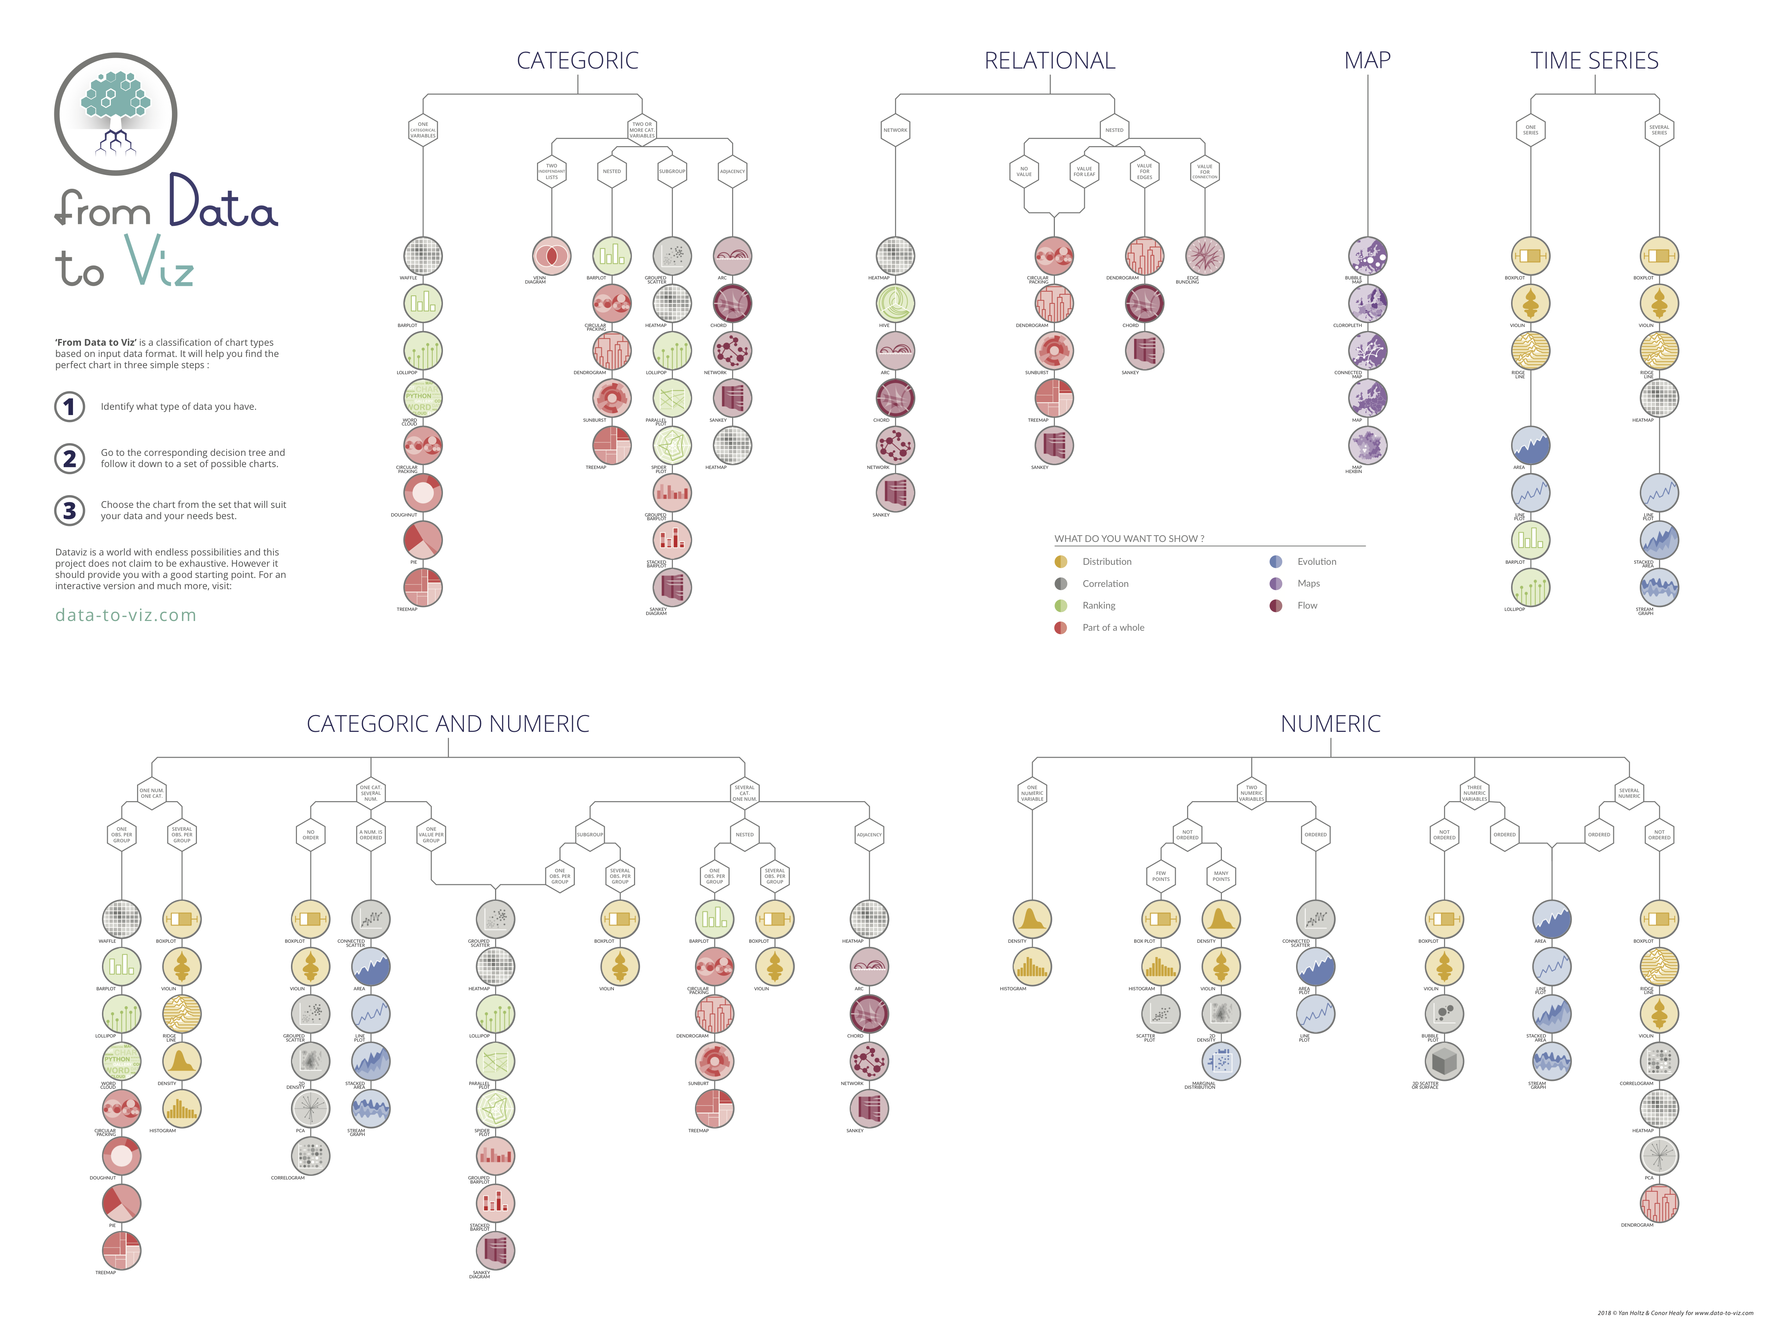
Notes:
+ WEBSITE DEMO

Slide 35
Data-to-viz.com
Notes:
Demo first part of the website

Slide 36
There are no limits in dataviz!
https://xeno.graphics/
Notes:
+ WEBSITE DEMO

Slide 37
WHAT YOU SHOULD DO
About 20 examples of storytelling with data
www.data-to-viz.com/#story

Slide 38
Eye catching / accurate
Question
Exploratory vs Explanatory
Chart Decision
Interactive or Static?
Who’s reading ?
Data itself

Slide 39
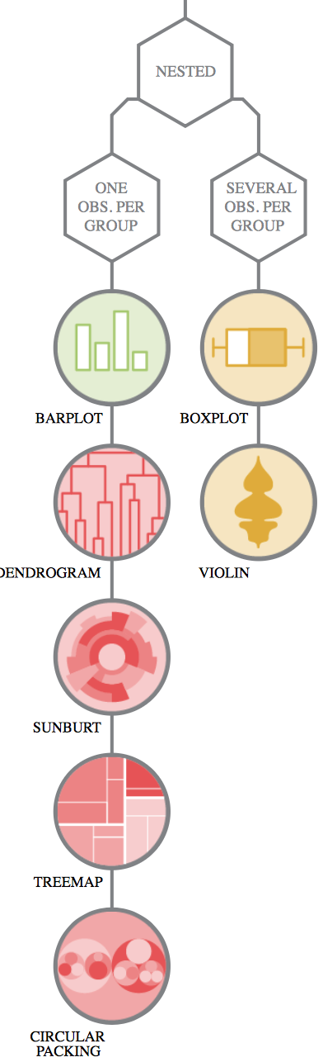
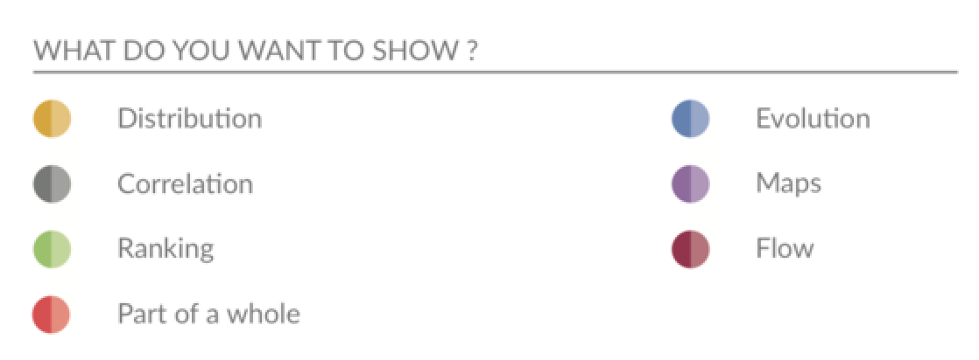
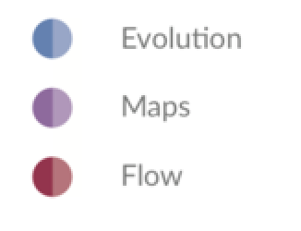
Question – Explo/Expla – Reader – Data – Interactivity – Eye catching
Notes:
Demo story part of the website Show that code is available

Slide 40
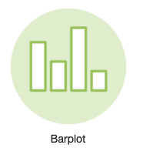
Who sells more weapons ?
South Korea > Spain ?
% of total sold by the US ?

Slide 41
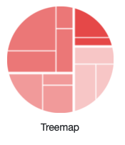
Who sells more weapons ?
South Korea > Spain ?
% of total sold by the US ?

Slide 42
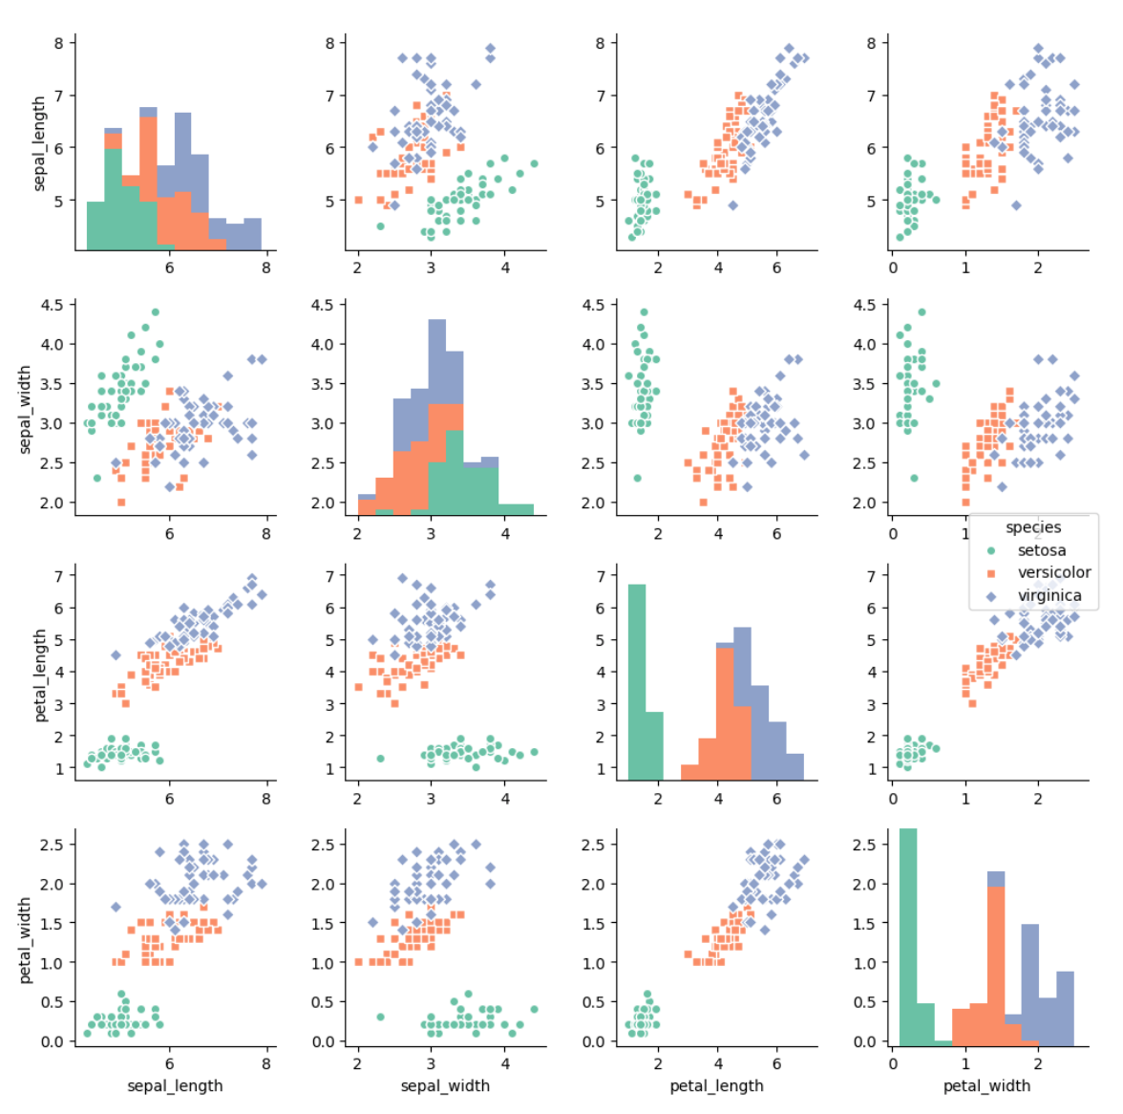
Question – Explo/Expla – Reader – Data – Interactivity – Eye catching
Notes:
Demo story part of the website Show that code is available

Slide 43
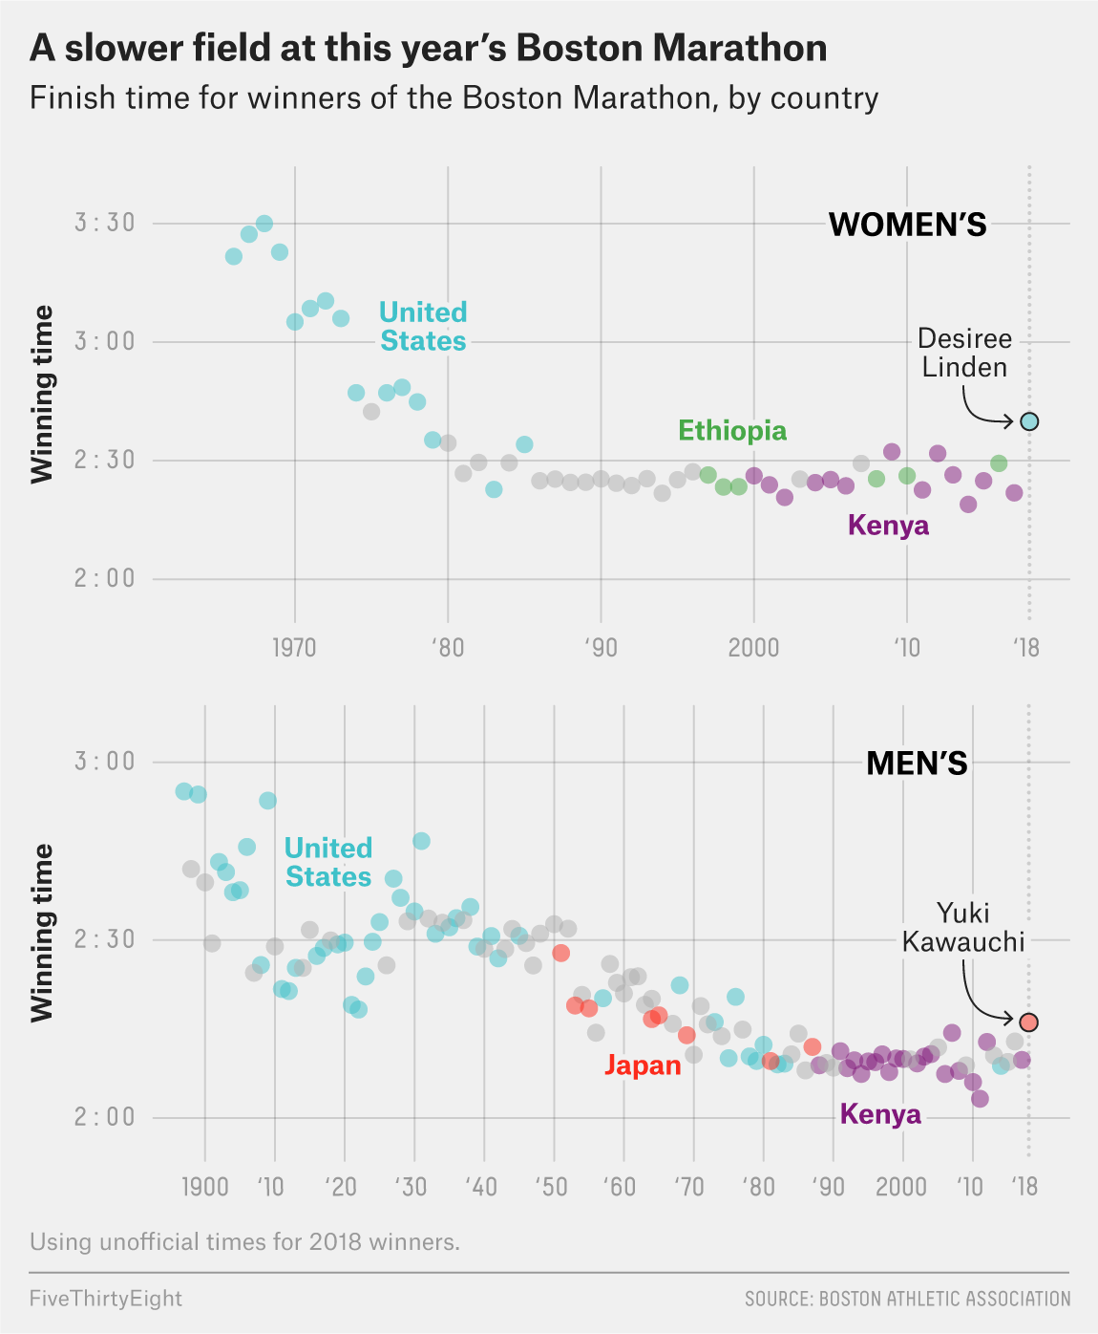
Question – Explo/Expla – Reader – Data – Interactivity – Eye catching
Communicate result
Show something specific
Tells a story
Five thirty height
Notes:
Dinéusorus

Slide 44
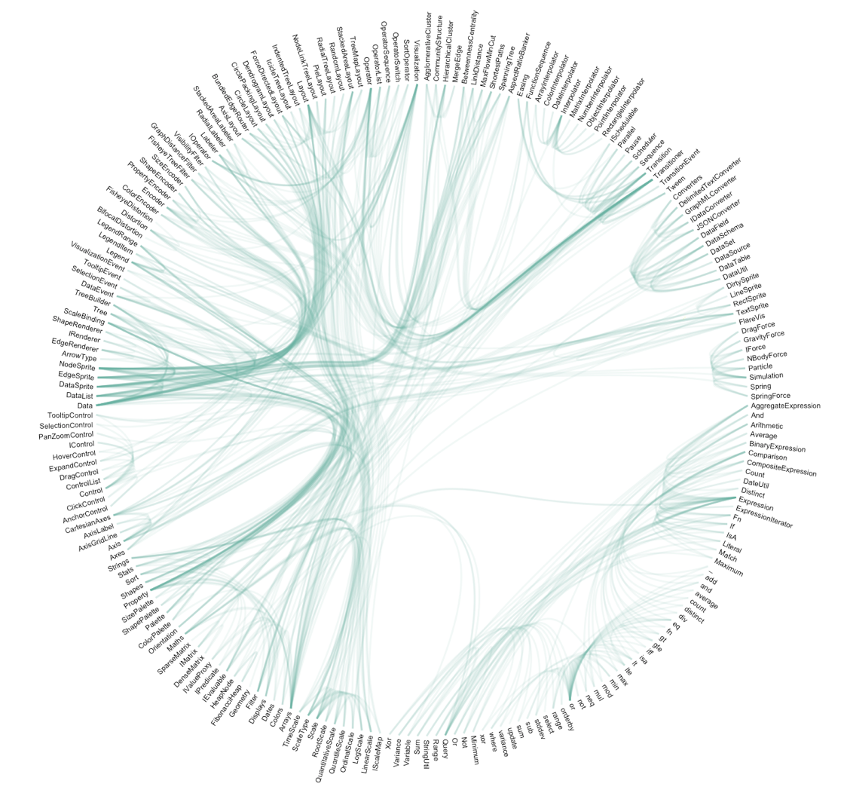
Question – Explo/Expla – Reader – Data – Interactivity – Eye catching
Notes:
Demo story part of the website Show that code is available

Slide 45
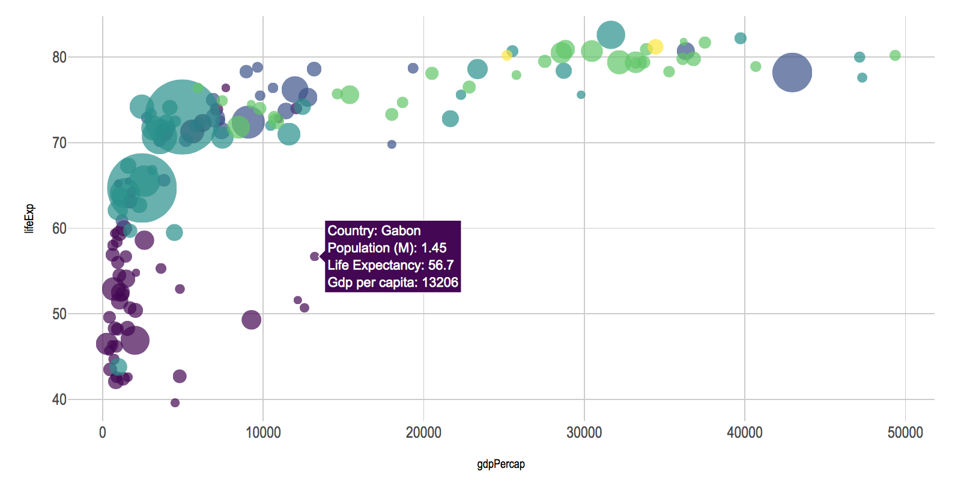
Question – Explo/Expla – Reader – Data – Interactivity – Eye catching
Notes:
Demo story part of the website Show that code is available

Slide 46
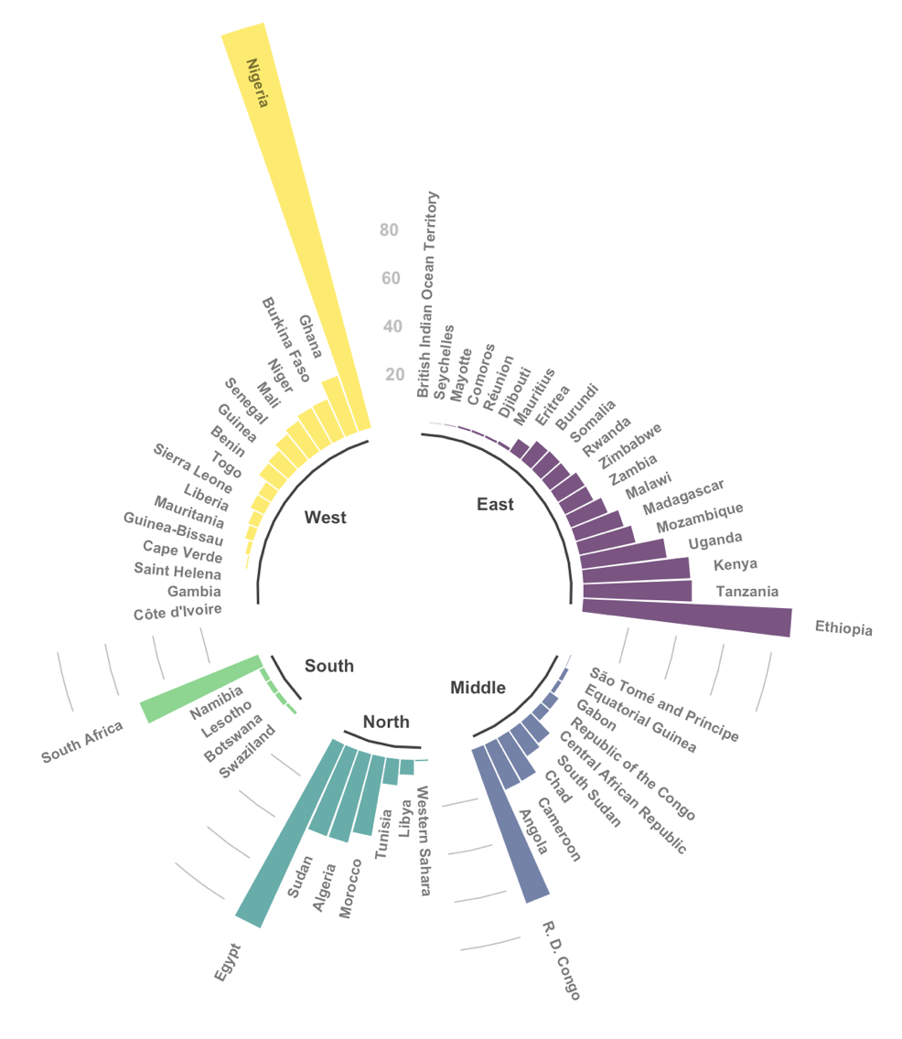
Question – Explo/Expla – Reader – Data – Interactivity – Eye catching
Notes:
Demo story part of the website Show that code is available

Slide 47
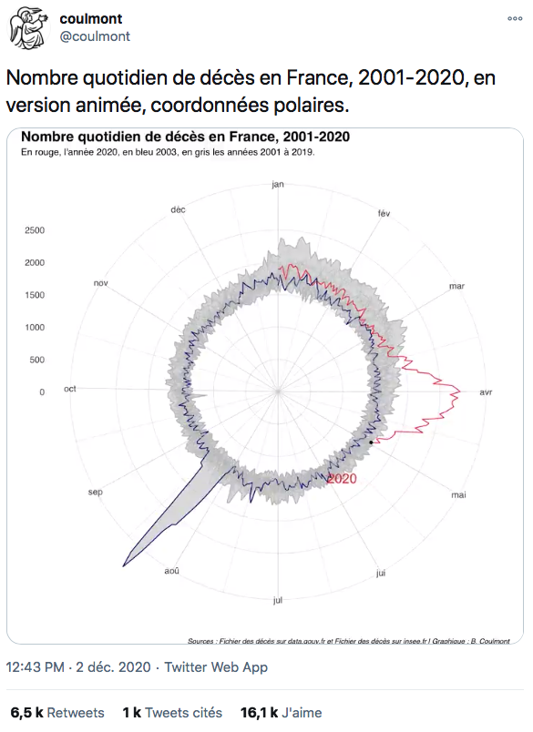
Link

Slide 48
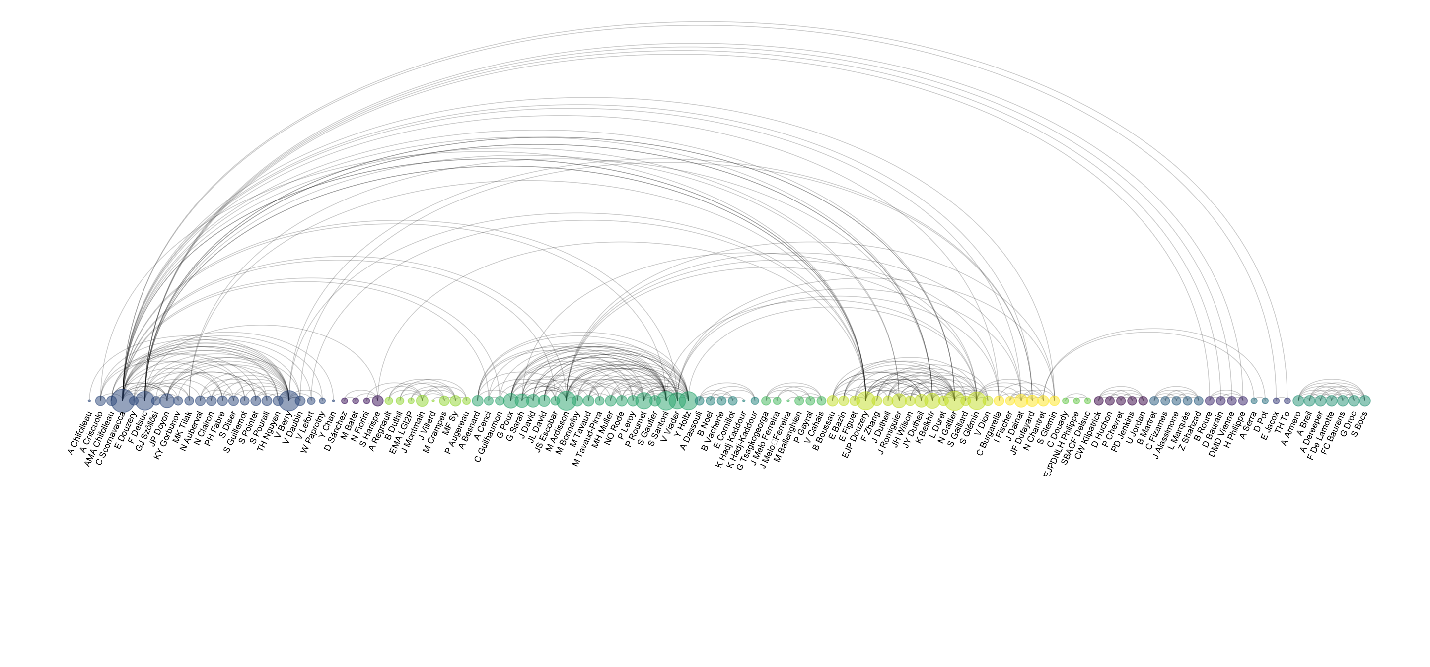
Co-authorship network of a researcher

Slide 49
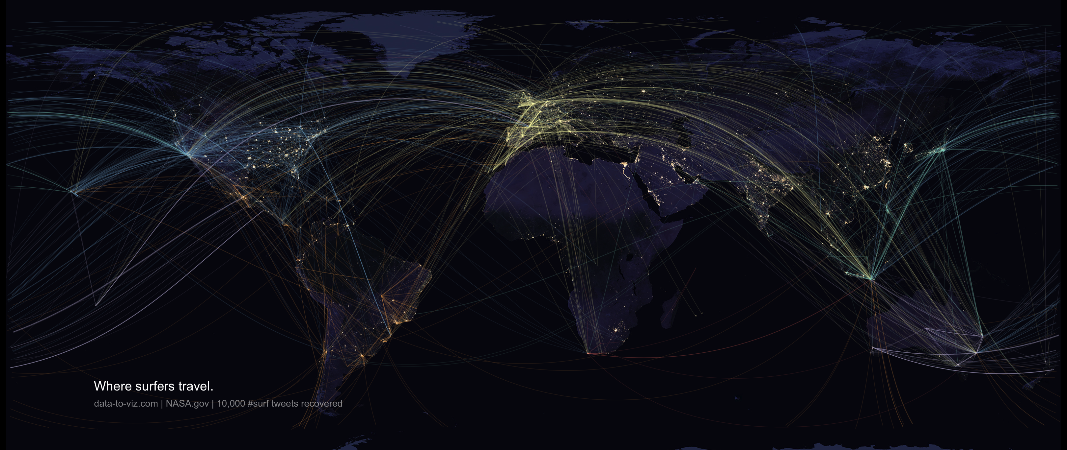

Slide 50
WHAT YOU SHOULD NOT DO
A gallery of most common caveats
www.data-to-viz.com/caveats

Slide 51
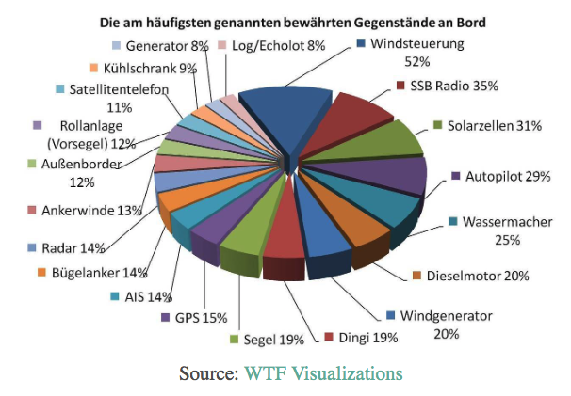
What’s wrong with this chart?

Slide 52
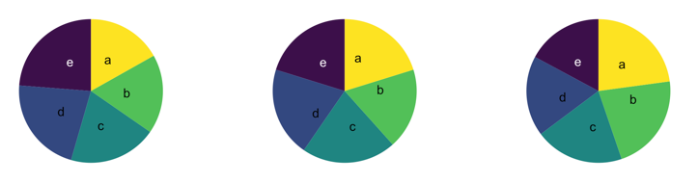
What’s wrong with pie chart?
What can you see?

Slide 53
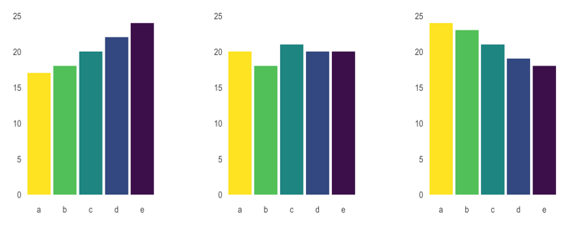
What’s wrong with pie chart?
It is hard to distinguish angles

Slide 54
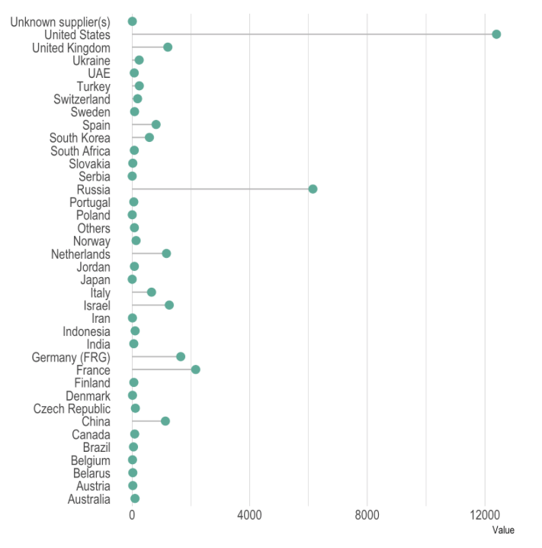
What could be better here?

Slide 55
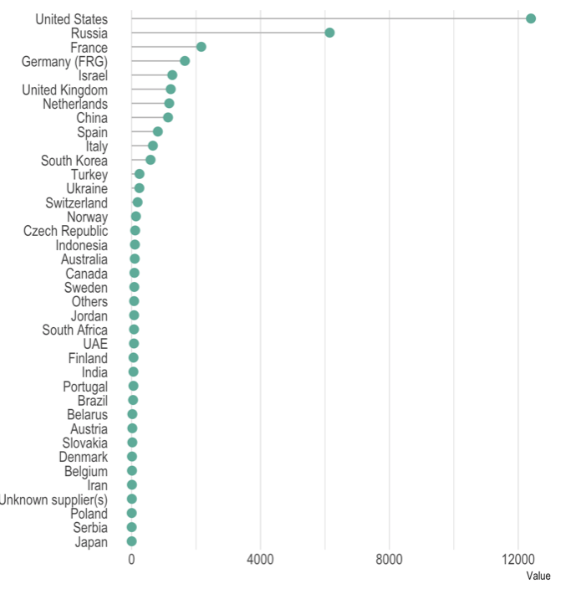
Order your data

Slide 56
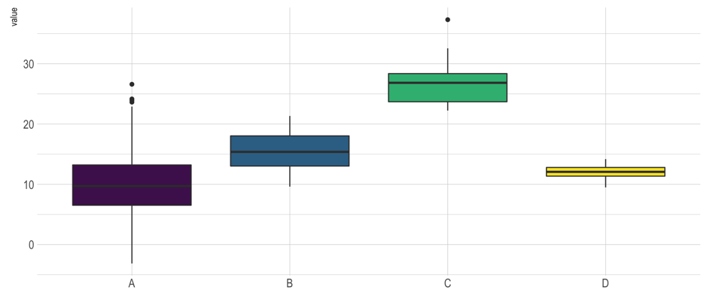
Anything wrong here?

Slide 57
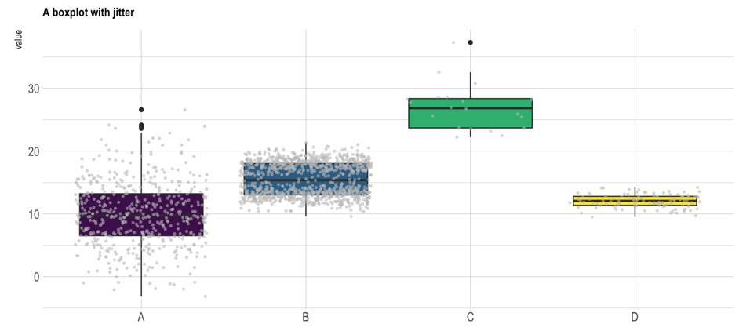
Boxplot = hide information
Almost no data !
Bimodal distribution

Slide 58
Boxplot = hide information
If small sample size, add data points with jitter
Almost no data !
Bimodal distribution

Slide 59
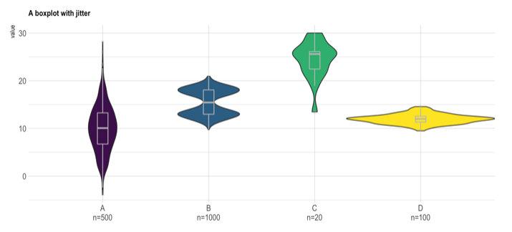
If big sample size, use violin plot
Show distribution
Show sample size

Slide 60
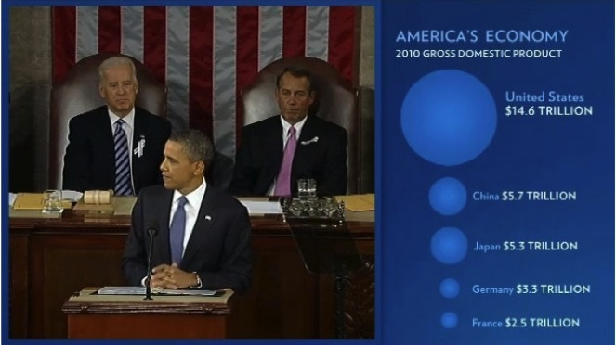

Slide 61
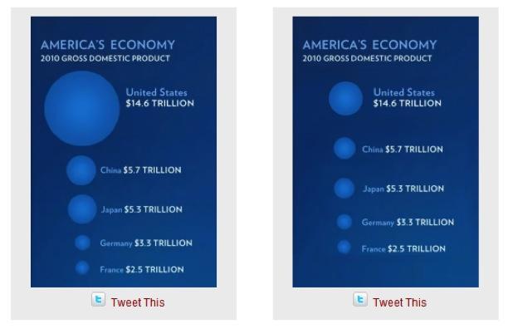
Size = radius
Size = area
Source: Fast Fedora blog

Slide 62
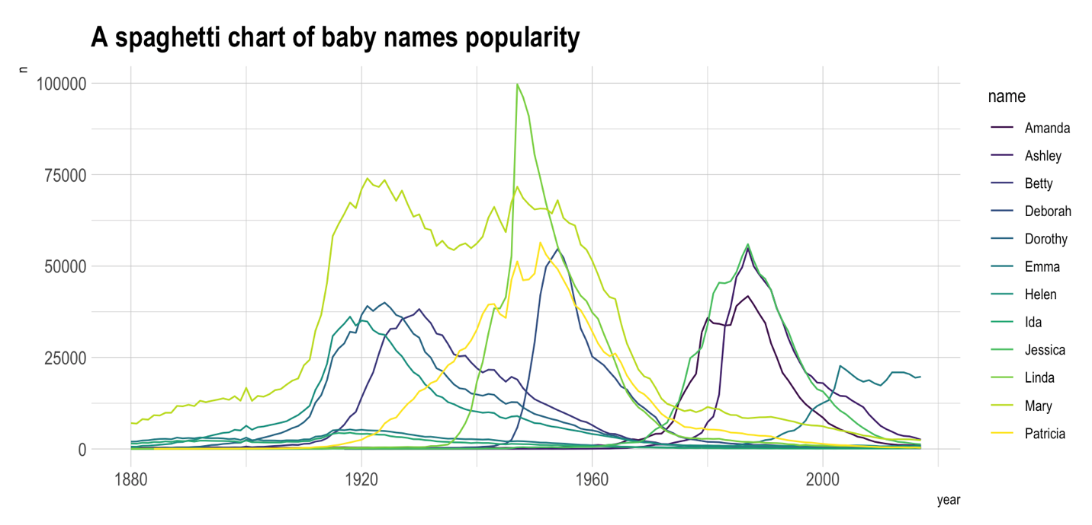

Slide 64
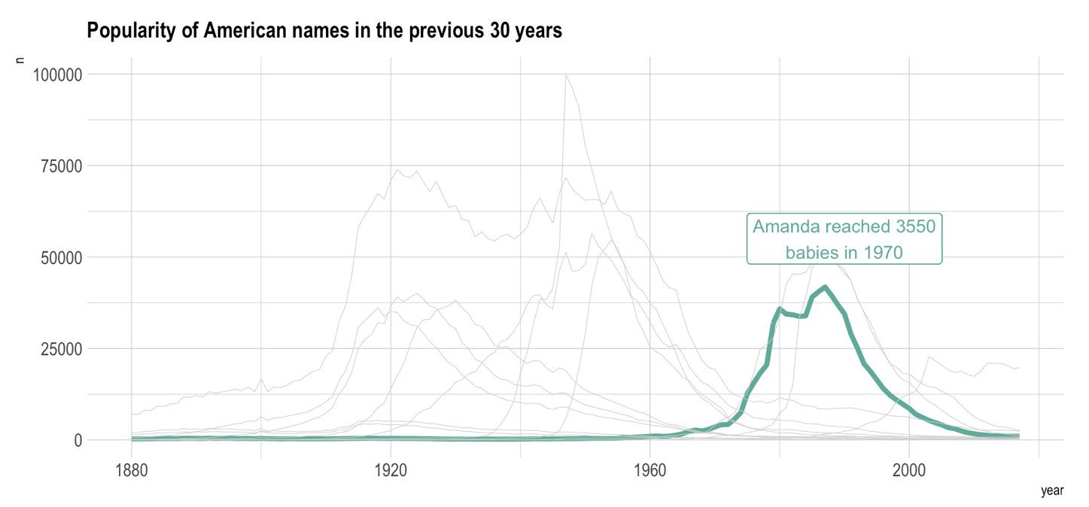

Slide 65
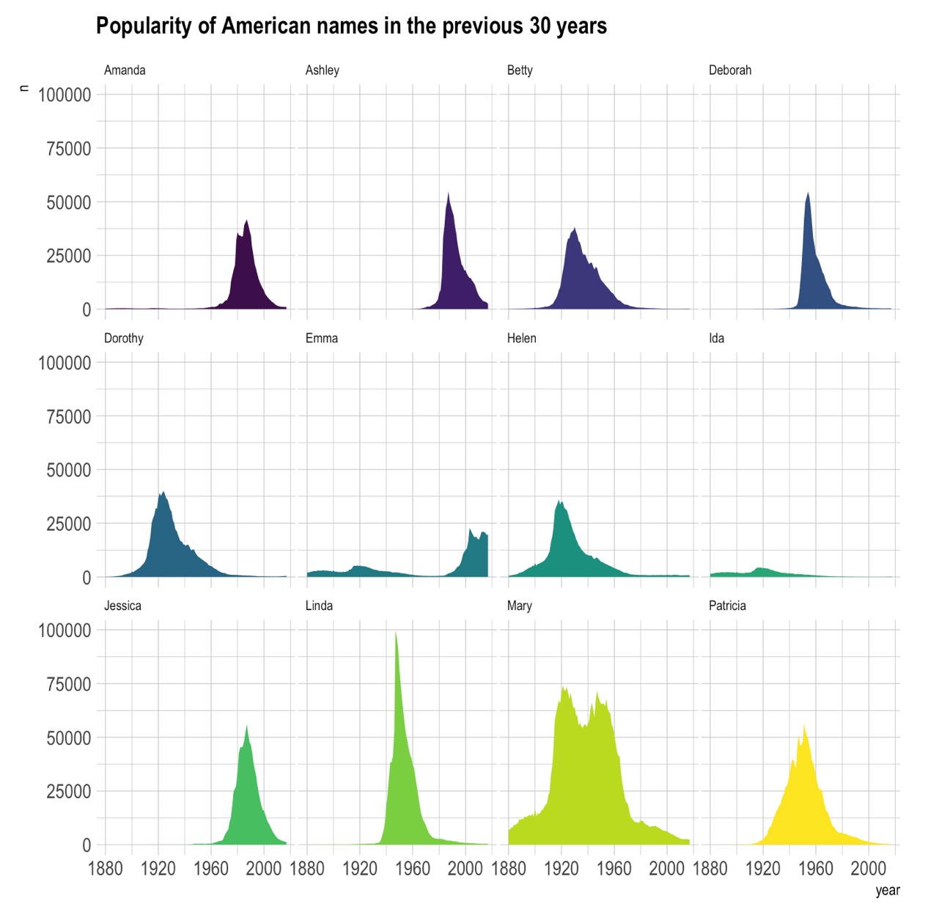

Slide 66
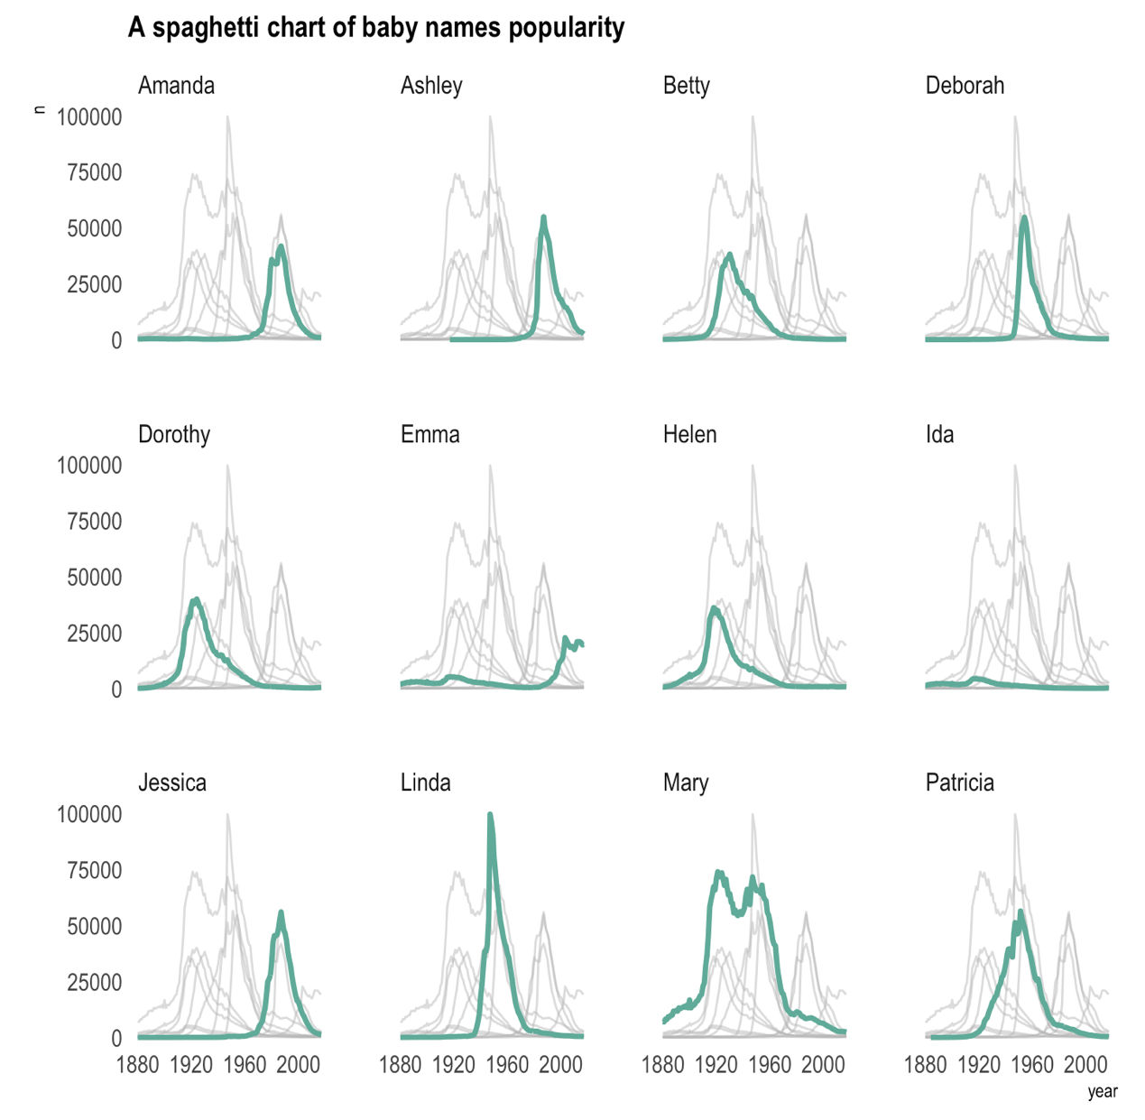

Slide 67


Slide 68

Data-to-viz.com/caveats
Data to Viz
A collection of dataviz caveats

Slide 69
HOW TO DO IT
The R and Python graph galleries

Slide 70
Design the idea
Build it
time
20 %
80 %

Slide 71

Easy
Limited
Hard
Flexible

Slide 72

Excel
Easy
Limited
Hard
Flexible

Slide 73
Data Wrapper demo
Data Wrapper
Flourish
Tableau
Jump
Excel
QlikView
Easy
Limited
Hard
Flexible

Slide 74
R graph gallery demo
Data Wrapper
R
Flourish
Python
Tableau
SAS
Jump
MatLab
Excel
QlikView
Julia
Easy
Limited
Hard
Flexible

Slide 75
Data Wrapper
R
Flourish
Python
Tableau
SAS
Jump
MatLab
Javascript,d3.js and the web
Excel
QlikView
Julia
Easy
Limited
Hard
Flexible

Slide 76



Slide 77

R-graph-gallery.com
Python-graph-gallery.com
D3-graph-gallery.com
Notes:
Demo d3-graph gallery.com

Slide 78





Data-to-viz.com
@R_Graph_Gallery
github.com/holtzy/Talk
Yan.holtz.data@gmail.com
www.yan-holtz.com

